Slide 1
Blubird
An Interactive Mobile Birdwatching App
By Patrick H. Meeker
General Assembly: Product Management
Notes:
Tell story of how I got into birdwatching. “Before I get into my presentation, I wanted to start off with a short story…”
For as long as I can remember, I felt I had an appreciation for our feathered friends. From the time I discovered that Dinosaurs were directly related to birds (compliments of Jurassic Park) to owning my own pet bird (a budgie parakeet named Fred btw), I had felt a strong connection to this species of animal.

Slide 2

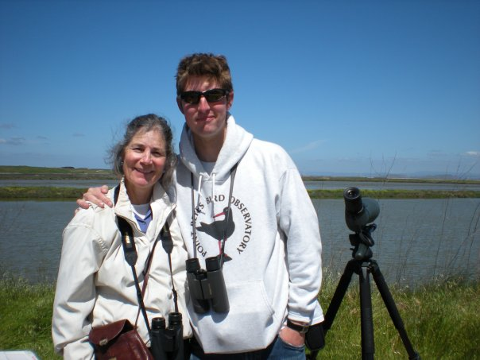
BluBird’s Story
Child fascination with the house Bird Feeder
Took Ornithology class JR Year at Lib Arts HS
As Adult, wanted to create an easy and interactive field guide/journal for avid and growing birdwatchers
Notes:
…Well it wasn’t until my mom bought a bird feeder and placed it outside our house. She then bought a big bulky field guide to identify all the different birds. It came to fruition my Junior Year of high school. I attended a liberal arts school here in SF and instead of taking an organic chemistry 101 course, there “Ornithology”, which is how I fell in love with the subject.
As I grew up and become more acclimated to the tech world, I realized that there is a potential niche to this industry.

Slide 3
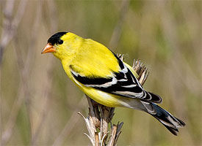
Agenda
Story (DONE!)
II. Market research
  Demographics
II. Product Overview
  Wireframes + Storyboards
  Features
IV. Financial Model
Assumptions/Risks
V. Next Steps
VI. Questions??
Can you Guess this bird?
Notes:
This is an overview of what we will be discussing
Think about what you see here with the characteristics of the bird: such as the shape, size, colors, etc. This will heavily apply to the success of this app

Slide 4
The Facts…
45.7 Million self proclaimed Birdwatchers in The U.S.
U.S. Spending on birdwatching
  $20 Billion annually*
  $3,400 per individual*
Market Sizing:
  Population of US – 350,000,000
  Average Age of Birdwatcher – 55 years old
  Population of US 55 year olds – 10,500,000
  U.S. Population of 55 year olds with smart phone – 2,625,000
Open $ on the table: Millions!
* Source: 2011 National Survey of Fishing, Hunting, and Wildlife Associated Recreation
Notes:
So let’s talk about what we do know… According to a 2011 survey from the National Survey of Fishing, Hunting, and Wildlife Associated Recreation…
Spending: The numbers have varied but most sources have claimed that on average total spending on birdwatching, which includes equipment i.e. binoculars, birdseed, and travel is somewhere between 20 billion and 32 billion Annually

Slide 5
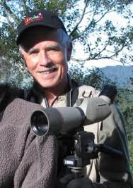
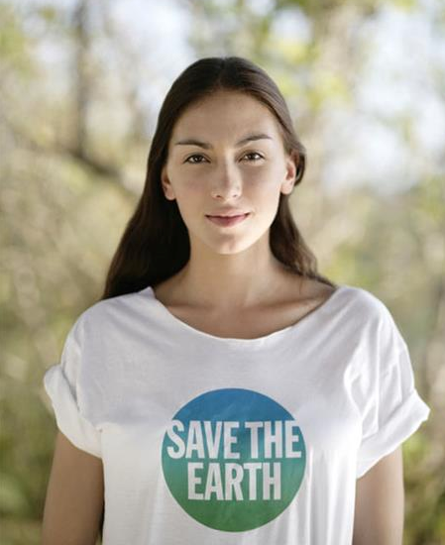
Meet our Customers
Allan
Background:
Teacher
15 - 20 Year Career
Married
Demographic
Yearly income: $60,000
Age 55
Beg – Med Tech Savvy
Values
Politically Liberal
Environmentalist and passionate about Birds
Volunteers 2x a week
Anne
Background
Works Non-Profit
Hikes 1-2x a week
Single
Demographics:
Female
Age 25
Yearly income: $40,000
Values
Wants to preserve Nature
Bird ID Novice through hiking and NP work
Notes:
Here are our 2 case personas for downloading and marketing the Blubird App. Story about he was my Ornithology teacher in HS 2001 and how he can market this to customer’s like Anne

Slide 6
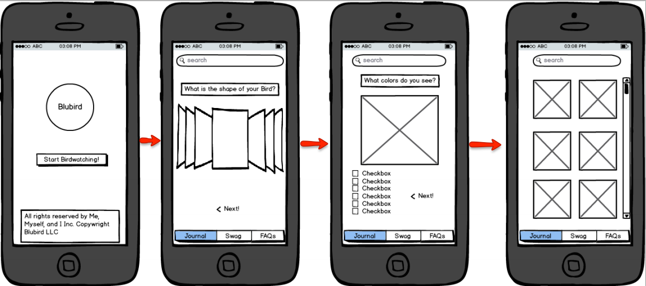
Expected Behavior
Notes:
So now you’re probably wondering, how exactly does BluBird work? Here is a brief overview of the steps one takes to get to the desired effect of the app, which I will now dive into. “Carousel of silhouettes”
Based on your location, you are given a database of birds

Slide 7
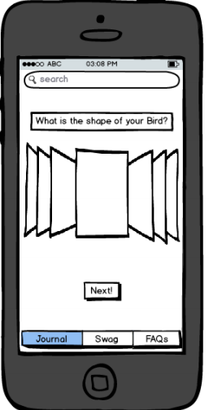
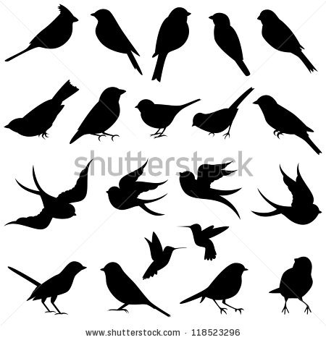
Step One: Spotting The Shape
Notes:
Users are given a “cover flow” template with a large database of bird silhouettes and once you see the bird you think matches the shape, you click on next

Slide 8
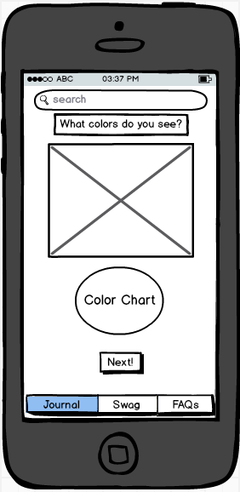
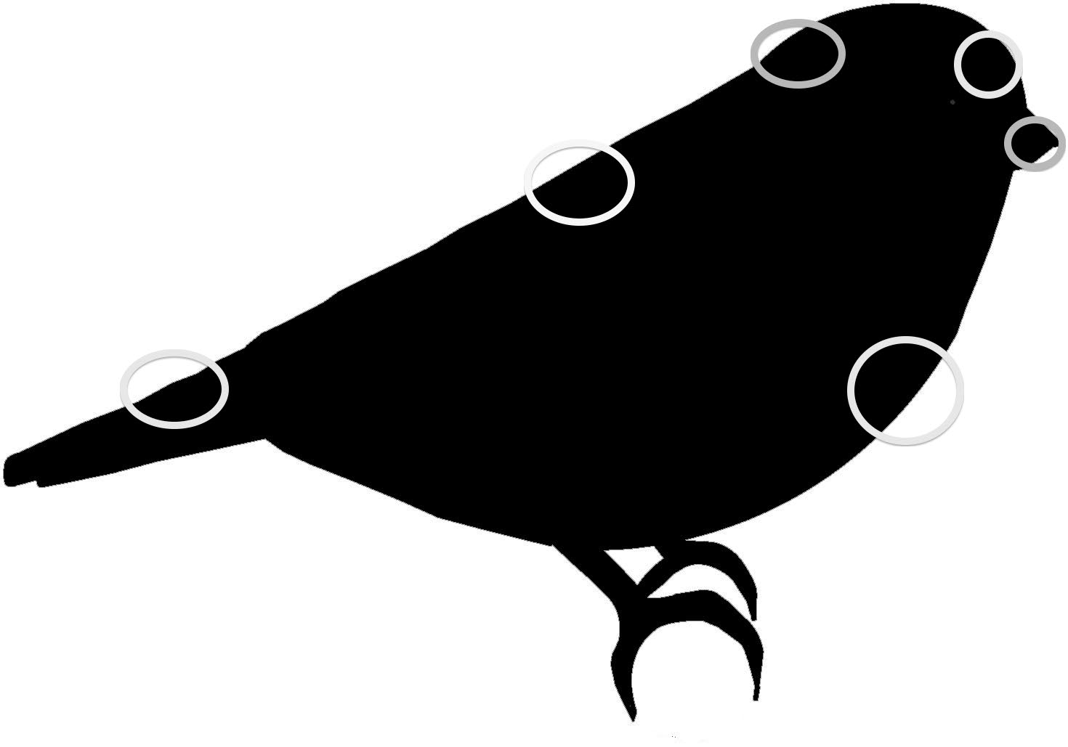
Step Two: Picking Your Colors
Bird silhouette as a “canvas”
Notes:
Given the layout of the silhouette, users can pick the colors they see on the bird based on either an interactive color schema

Slide 9
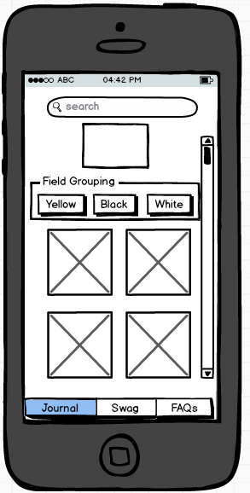
Step 3: Based on Your Search..
Vertical Scrolling for easy search
Bird Silhouette
Filtered colors
Once you have selected the bird based on what you saw…
Your search results

Slide 10
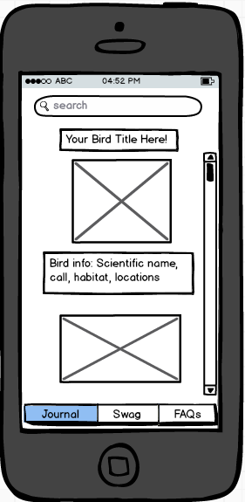
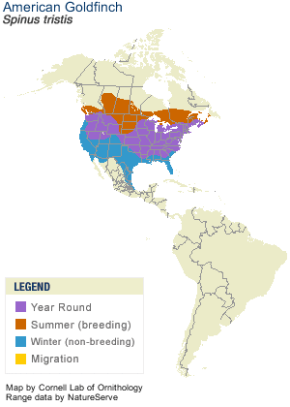
Ta-da – Your Bird!
American Goldfinch
A Small Finch with a short, conical bill. Very active and acrobatic that cling to weeds and seed socks, etc…
Distro map of where Bird can be found
Notes:
Based on your search filters on the shape of the bird, what colors you see, and where your location is, it will produce a the splash page of the bird with an image of the bird, a brief bio, and where it can be found in the U.S. at what times of the year

Slide 11
Assumptions / Risks
  Assumptions
  Alan and Anne own an smartphone/tablet
  Are outdoors or in a populated bird area i.e. park, wildlife preserve, zoo, etc.
    Or has a Bird Feeder
  Has good visibility
  Bird watching Year Round
  The Technology does not yet exist!
  Financials
  Minimal Outsourcing Cost based on Simple, Table Based app formula
    ~ $5,000 to provide all the content and clear direction
  Charge $0.99 per download
  3% growth per Mo
Notes:
I wanted to be as conservative as possible on my figures. Outsourcing can cost anywhere from $1000 - $4000 based on what you provide and what you would like it to do.
Competition: slightly red ocean but all the bird apps are databases NOT search functions and I am undercutting them

Slide 12
BluBird Growth Y1
Projected Revenue Y1: $1,084,665.41 at flat 3% monthly growth
Base Cost: $5,000
Misc Adjustments:
$108,466.54 (10% Rev YTD)
30% Rev Apple Fees*
Quarterly Review:
Q1 - $225,338.44 (Intro to Mkt)
Alan and Anne are users
Q2 - $ $253,475.10
User Feedback
Q3 - $ $285,125.01
Feature Optimization
Q4 - $320,726.86
Holiday Push
Net Profit: $ $971,198.87
Notes:
I clearly am not in this business to become a millionaire. IOS will give me the best reach but it will also be the most expensive ($99 apple fee + 30% for each sale)
In the end, I can make enough to pay off this class!

Slide 13
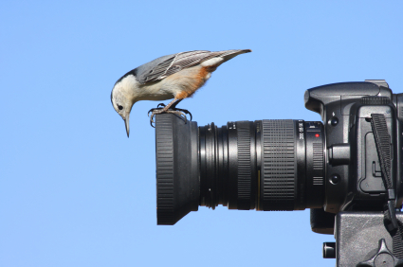

What lies ahead
Development
  3P Developer Simple, Table based app
    “Scrape” Database
Introduction
  Market to schools, Bird and nature conservatories
  Start with small and local database (low cost)
Growth
  New features (Premium Version) - ~$9.99 – $19.99
    Picture ID with your camera phone?
    Social Media “Good Year” Component
    Expand database to Other parts of world
Maturity
  Further research into Photo based search
  Sound ID
    Think Shazaam
Decline
  New ID Niche
    Other Animals, Plants
  Acquisition?
Notes:
Now I already talked a little bit about the development and introduction piece through our demographic piece and assumption piece
Audubon society

Slide 14
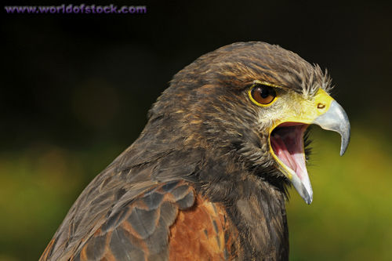

Questions??

